Slide 1

National well being vs. Governmental Education Expenses and the impact of COVID-19 on National well being
By Erica Jarrells, Lainey Lowe, Sophia Manning, Tiana Medina, and Jaaron Boone
Notes:
Today I will be talking about whether there is a correlation between government spending on education and national well being and whether there is a correlation between income, education, and fatalities from COVID-19 in the United States.

Slide 2
Table of Contents
Introduction
Process
Government Expenditure on Education vs Nation well-being
Attributes
Gov. Expense on education for large GDP nations
GDP vs. Education expenditure
GDP/per capita vs Education expense/per capita
More figures
Continued
GDP/ per capita
Education cost
Life expectancy
Conclusion
Effects of COVID-19 on the United States
Fatalities vs. Education
Fatalities by Age
Fatalities vs. Income
Conclusion
Additional Findings
Population and Budget Observations
Conclusion
Notes:
During this presentation I will begin by providing an introduction and describing our overall process. Then, I will discuss the findings for government expenditure on education vs nation well-being. Followed by the effect of covid-19 on the US, additional findings, and the conclusion of our findings.

Slide 3
Introduction
Hypotheses:
Positive correlation between government expenditure on education and nation wellbeing
No correlation between income and education levels on COVID-19 fatalities in the United States.
Notes:
In this project, we seek to answer the following questions:
Is there a strong connection between nation well being and government expenditure on education?
Is there a correlation between income, education level, and fatalities from COVID-19 in the U.S?
We formulated hypotheses to each of these questions. We hypothesize that there will be a positive correlation between government expenditure on education and nation wellbeing.
As government expenditure on education increases, as will nation well being.
For our second research question, we hypothesize that there will be no significant correlation between income, education levels, and COVID-19 fatalities.
As income or education levels increase and decrease, the rate or number of COVID-19 fatalities will not respond in any particular way.

Slide 4
Process
Data collection & hypothesis
SAS reports/hypothesis testing
Analysis
Draw Conclusions
Notes:
We began by collecting data on 20 countries from the last 15 years. The data collected included population, GDP, life expectancy, government budget, and government spending on education. The hypotheses were formed and then the data was uploaded to SAS to begin generating tests and reports. Next, we analyzed the tests and reports from SAS to draw conclusions to see if our hypotheses were correct.

Slide 5
Government Expenditure on Education vs. Nation well being

Slide 6
Attributes
Nation wellbeing can be defined using GDP/per capita and life expectancy of the country as a measure

Slide 7
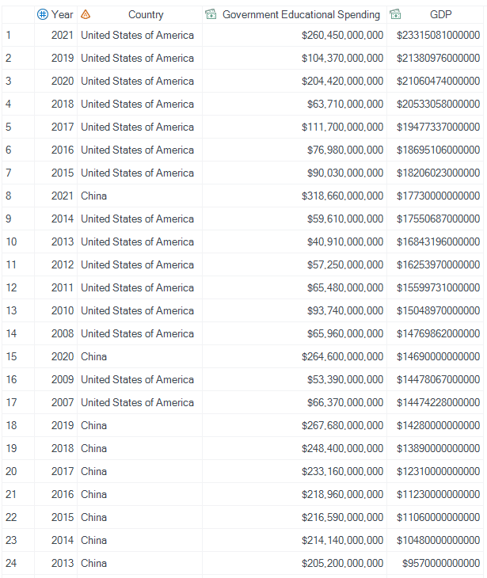
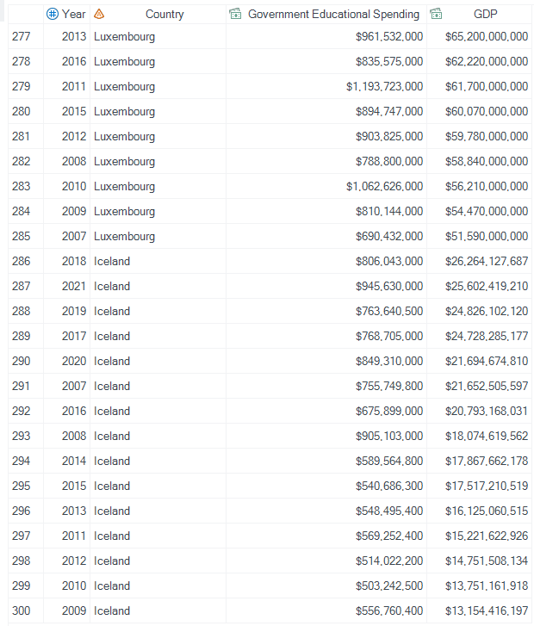
Government expenses on education for large GDP nations
Major Takeaways:
US and China– top GDP for most years.
China had unusually good year in 2021
US high GDP recent– inflation?
Luxembourg and Iceland– lowest GDPs.
Low population?
Education spending notably higher for large GDP countries
See full data here
Notes:
China and The United States had top gdp for the most years. Altough the United States consistently had the highest GDP out of all of the nations that we collected data for.
China had an unually high GDP in 2021
The highest GDPs are also notably from 2019 and 2021. One such reason could be that this data does not account for inflation.
Luxembourg & Iceland has the lowest GDPs of that nations that we collected data for.
Education spending is notably higher in large GDP nations.

Slide 8
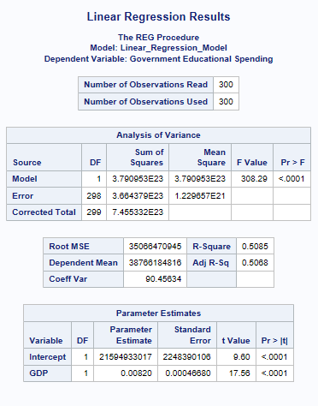
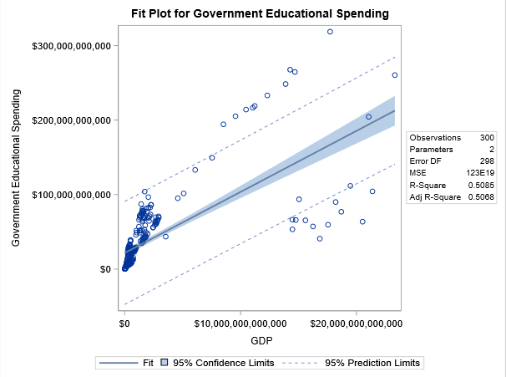
GDP vs. Education expenses
Major Takeaways
Generally linear, with major outliers in high GDP countries
Data is skewed
Many countries with low GDP
High GDP countries have variability in spending
R-square 50.86%
not high enough to conclude strong correlation
P-value associated with f-value is > alpha 0.5
Further conclusion of a lack of strong correlation
See full data here
Notes:
The generated linear regression report indicates a lack of a strong correlation between the two variables. The data is skewed due to there being so many countries with low GDP and the countries with high GDP, vary in the amount that is spent on education. The r-square value sits at 50.86% and 50.68% for the adjusted R-Square. Both indicate a lack of a statistically strong correlation between the two variables.

Slide 9
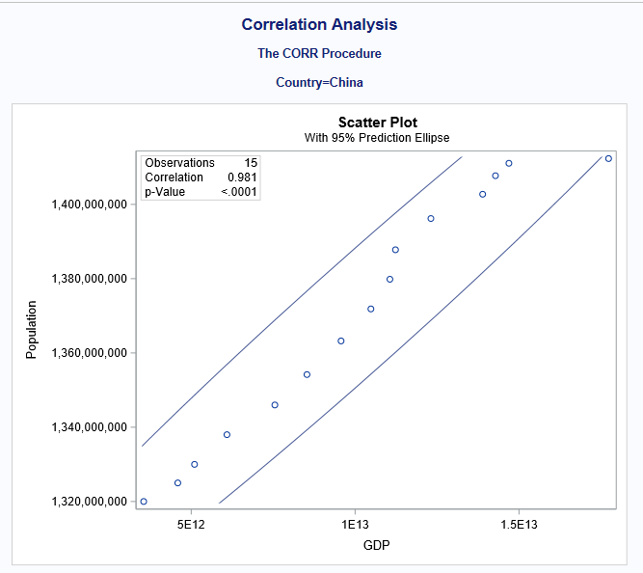
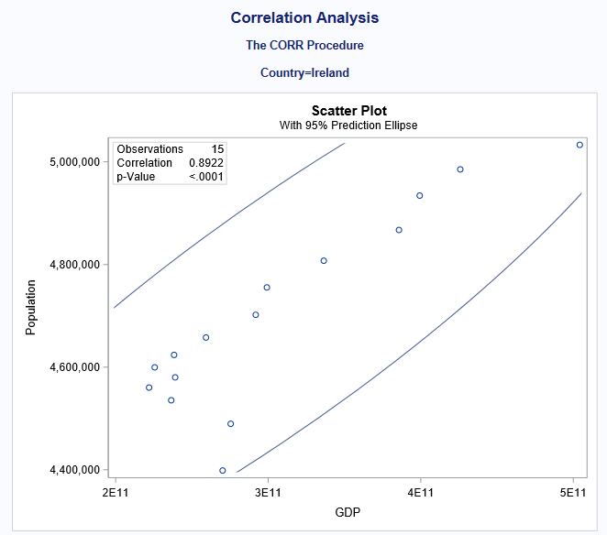
GDP/per capita vs Education expense/per capita
Major Takeaways
Strong correlation in high GDP countries & education expenditure
Support the hypothesis that as education expenditure increases, as does the nation well being measure of GDP
See full data here
Notes:
The images shown on this slide and the next slide showcase all countries with heavily correlated GDP and Education expenses
When looking at high GDP countries, it supports the hypothesis that as education expenditure increases as does the nation well-being measure of GDP

Slide 10
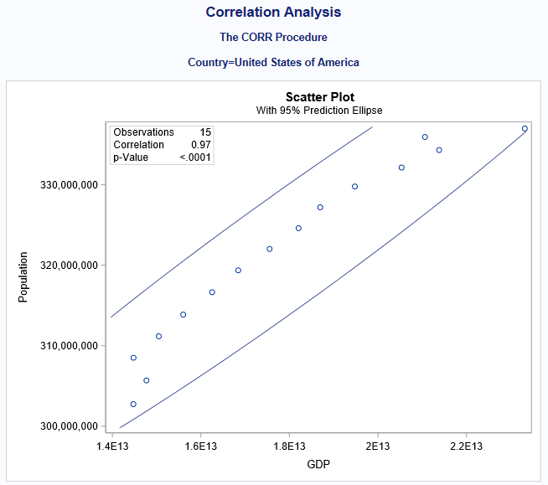
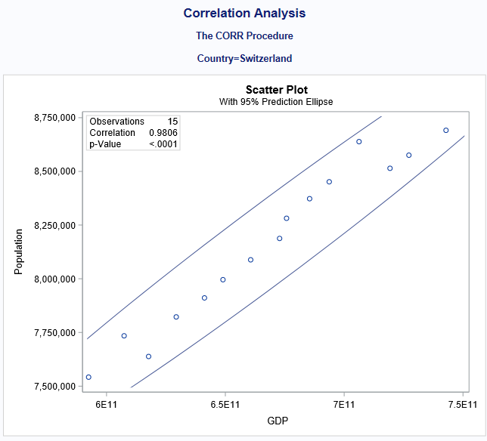
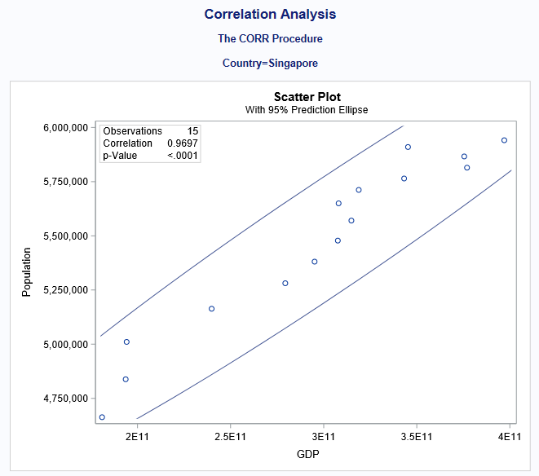
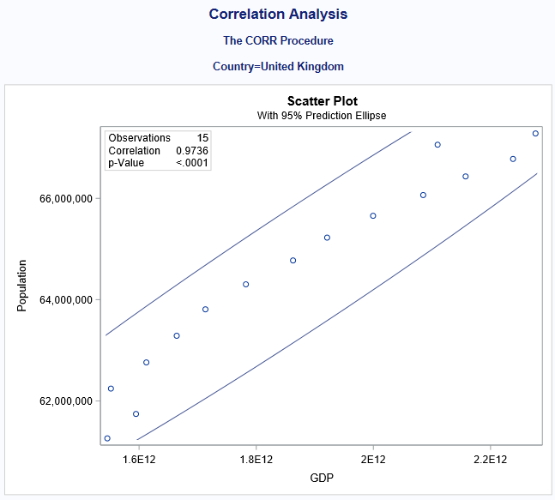
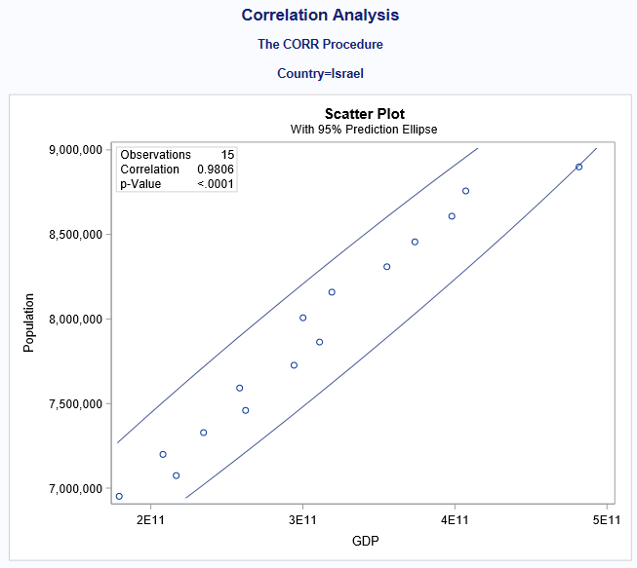
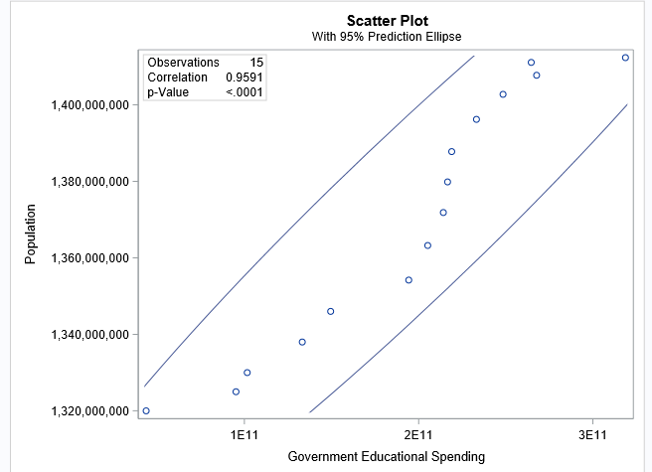
Country– China
Notes:
This is a continuation of the last slide of countries with high correlation between high GDP and education expendature.
Some things to note are
Most correlated appears to be Israel and Switzerland with 0.9806 correlation
All appearing countries have p-Value <0.001
Supports hypothesis
Non-appearing countries weren’t necessarily not correlated– just not as strong of a correlation

Slide 11
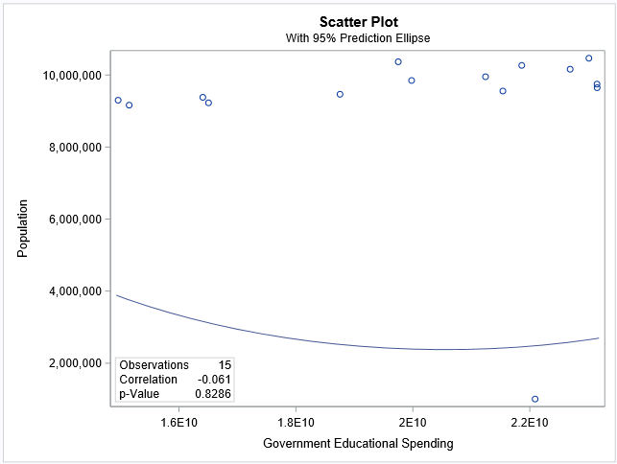
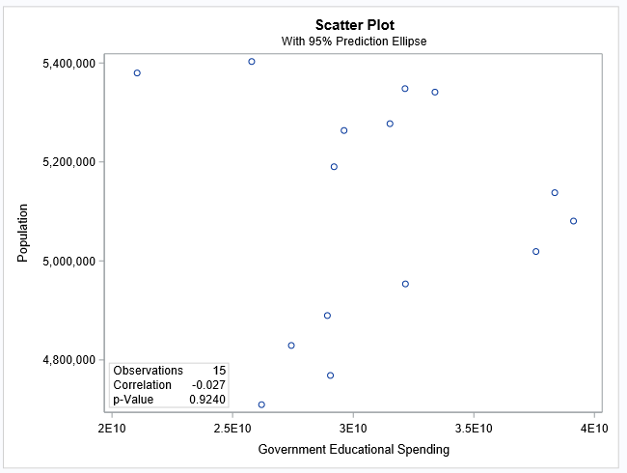
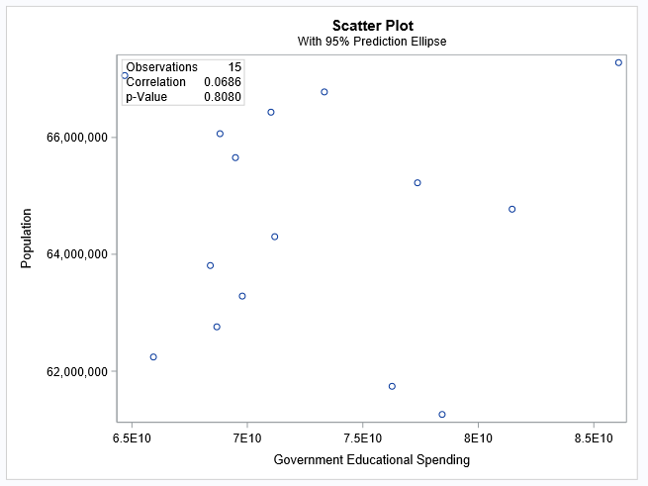
GDP/per capita vs. Education expense/per capita
Least correlated with p-Value = above 0.8
0.9420 = Norway
0.8286 = Sweden
0.8080 = United Kingdom
Notes:
Notable– these countries notoriously offer a lot of social programs and public support
High taxes but lots of social welfare
Particularly in Sweden and Norway
Negative correlation values for Sweden and Norway– could indicate opposite relationship (as GDP goes up, education expense goes down)

Slide 12
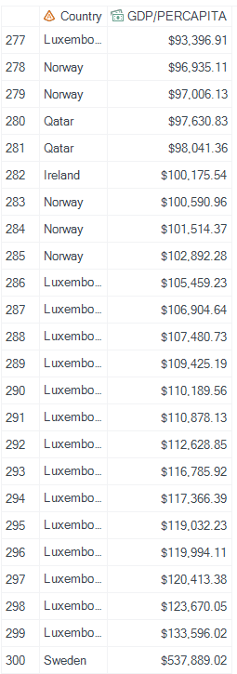
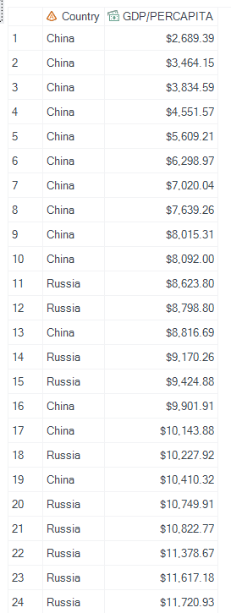
GDP/per capita
Major Takeaways
Shown– High and low GDP/per capita
Low GDP/per capita–
Countries with high populations
China has consistently lowest
High population buffs the amount of money per capita
High GDP/ per capita
Luxembourg has continually highest
Interesting because low overall GDP, but highest per capita
Lower populations
Makes sense– small, rich countries tend to have higher GDP
Inflates amount per capita
A few outliers– Sweden and Ireland made solo appearances
Good financial years?
See full data here

Slide 13
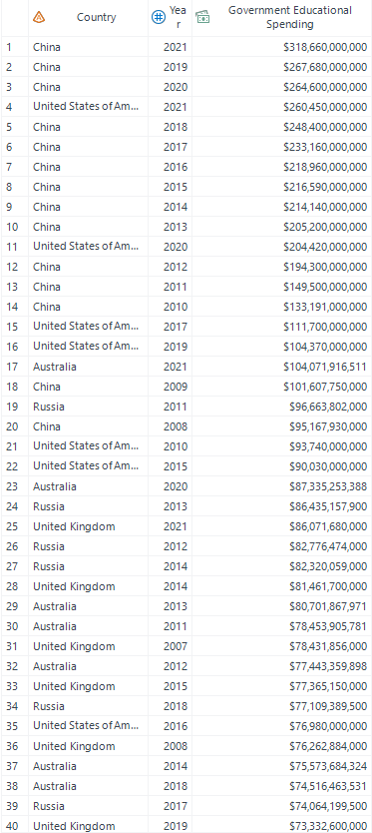
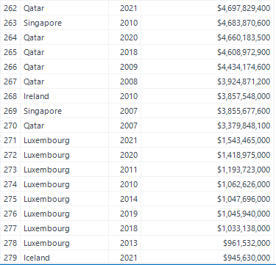
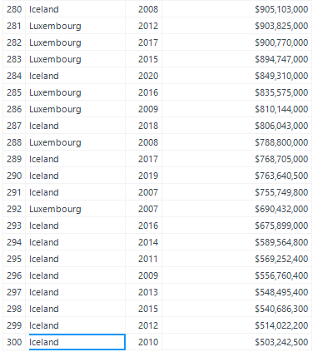
Education cost
Major Takeaways
Shown– Top and bottom education expenditure
China on top, but has lowest GDP/per capita
Luxembourg on bottom, but has highest GDP/per capita
Well-developed industrialized nations high up
Small nations with low populations towards bottom
Less people so don’t need to dedicate as much money to education
Highest education spending is recent (2019, 2020, 2021)
See full data here
Notes:
Highest education spending occurred in 2019.2020.2021
China spends the most on education but has the lowest GDP per capita
Luxembourg spends the least on education but has the highest GDP per capita.
Well developed countries appear to spend the most on education
Small nations with low populations tend to spend the least

Slide 14
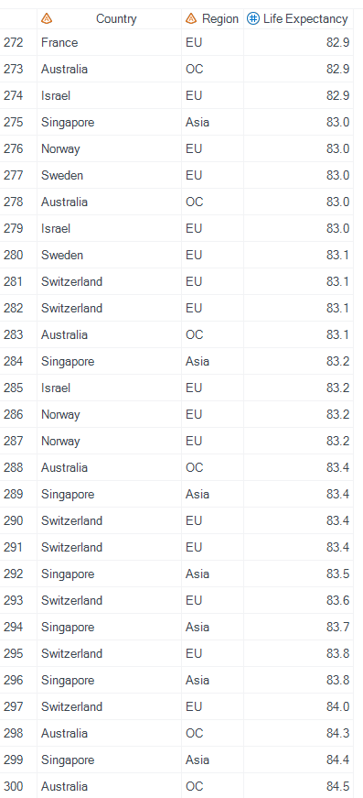
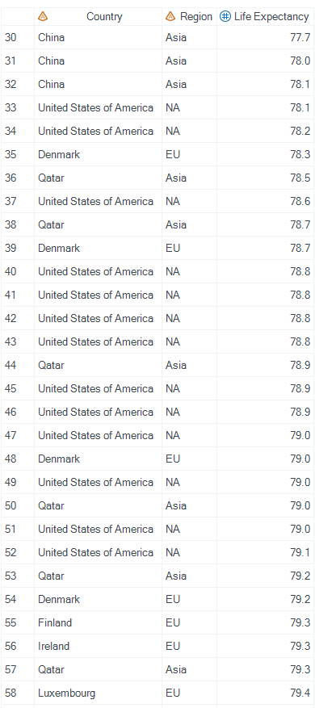
Life expectancy
Major Takeaways
Shown– highest and lowest life expectancies
Lots of EU nations in top life expectancy
Lots of differentiation and ties– no one nation consistently at the top of the list
Nations with heavy social programs (Norway, Sweden) make appearances high up
Switzerland, Singapore, and Australia all in top
Interesting how they are all from very different regions
High education expenditure nations like China and the United States have lower life expectancies
Qatar and Luxembourg low end of life expectancy
See full data here
Notes:
Many European nations have a higher life expectancy
One nation doesn’t consistently appear at the top of list of having highest life expectancy
Nation such as Norway and Sweden with heavy social programs have higher life expectancy
Switzerland, Singapore, and Australia also appear to have a higher life expectancy
High education expenditure nations such as the united states and China have lower life expectancy.

Slide 15
Conclusion–Is there a strong connection between nation well being and government support/expenditure on education?
Conclusion
Not a strong correlation between GDP and life expectancy
Lower GDP and higher GDP countries skew the data
Other Findings
Nordic countries have negative correlation between GDP and education expenditure
High taxes but access to public support
Notes:
Based on the gathered evidence and analysis, we have found that there is lack of a strong correlation between nation well being (GDP and life expectancy) and government support and expenditure on education. While a lot of the middle-ground countries had data that supports the idea, the lower and higher ends of education spending and GDP were opposites. They would look the same if a strong correlation exists. This is because in the data there is the interesting idea that large nations with low GDP will spend more on education because of high populations, and small nations with high GDP will have low education spending because of lack of population. Basically, since GDP/per capita and government spending on education are determined by population, but in opposite directions, the far ends of the spectrum do not follow a pattern of correlation. To rectify this, further research could be done about the percentage of government spending being dedicated to education. This would provide a better idea of the importance a nation’s government places on education.
Nordic countries (Sweden, Norway) do not have a positive correlation between GDP and education expenditure. In fact, they tend to have negative correlation. These countries have notable differences in the structure of social programs from other countries in this study– they have high taxes but widespread access to public support, services, and programs, like for example, quality education. This may be because the governments act in a response measure– as their GDP increases, governments may tax more, and therefore have more money to be funded into education to encourage development and innovation.

Slide 16
Effects of COVID-19 on the United States
Notes:
To recap, we hypothesize that there will be no significant correlation between income, education levels, and COVID-19 fatalities in the United States.
As income or education levels increase and decrease, the rate or number of COVID-19 fatalities will not respond in any particular way.

Slide 17
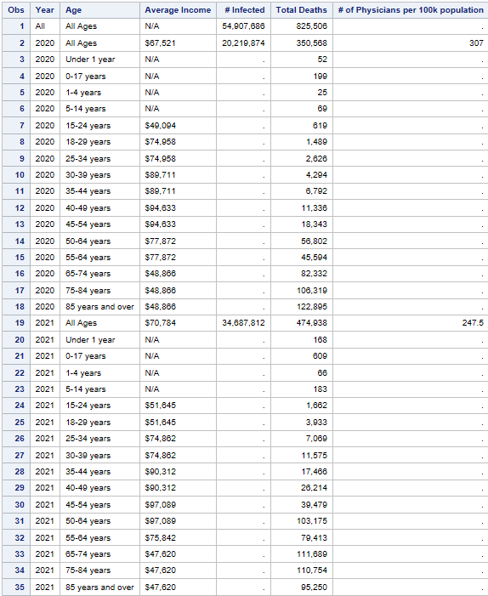
COVID-19 in the United States– Comprehensive data
Fatality numbers were higher in 2021 for all ages than in 2020.
2021- 474,938 deaths
2020- 350,568 deaths
Number of physicians was higher in 2020
Total deaths made up 1.5% of all infected cases overall
1.7% in 2020
1.3% in 2021

Slide 18
COVID-19 fatalities vs. Education in U.S.
Major Takeaways
Death rate notably higher for less-educated population
Death rate the same for college graduates and post graduates
Additional Considerations
Could have to do with lack of knowledge and resources about vaccinations / preventative measures / when to seek medical attention.
Could also have to do with generational differences– a lot less likely to pursue college or even finish high school for older generations who are also at high risk of death.

Slide 19
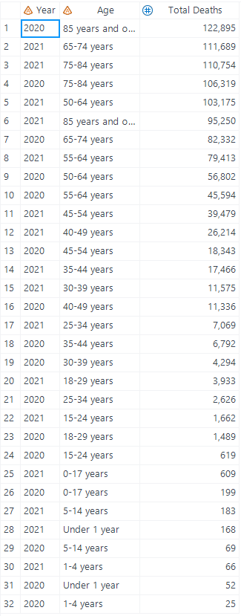
COVID-19 fatalities by Age in U.S.
Major takeaways
Correlation between number of deaths and age. As age increases, as does the number of fatalities.
More likely to have other illnesses and conditions impacting recovery
Simple symptoms can be exacerbated by existing conditions and other ailments that come along with old age
Under 18 fatalities were minimal
Death tolls higher in 2021 than 2020
Notable increase in fatalities from ages 40 to 50

Slide 20
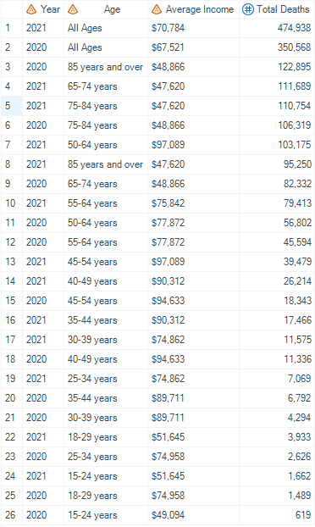
COVID-19 fatalities vs. Income
Major Takeaways
There is no discernible correlation between income and the number of COVID-19 fatalities
Most high incomes (upwards of 90k) are close to middle of total deaths
The highest average income was $97,089 for age group 50 - 64 years old in 2021.
Total deaths– 103175
Lowest average income was tied for 3 different age groups. It was $47,620 for 65 and up.
Could be because of social security payouts– makes average income around the same?

Slide 21
Conclusion– Is there a correlation between income, education level, and fatalities from COVID-19 in the U.S.A?
Conclusion
Some correlation correlation between COVID-19 fatalities, age and education
Lack of a strong corrections between COVID-19 fatalities and education
Notes:
Based on the gathered information, it can be concluded that there is some degree of correlation present between COVID-19 fatalities and age, and COVID-19 fatalities and education. This makes sense, as higher age groups are more likely to succumb to the symptoms of COVID-19 due to increased immunocompromisation and the present of other health concerns.. The education level may tie into the correlation with age– older generations are less likely to be as educated due to lack of access or lack of need for further education. Additionally, a lack of education may make an individual less likely to seek treatment for COVID-19, and less likely to consider vaccination or other preventive measures like mask wearing.
Income appeared to have no discernable impact on the quantity of fatalities.

Slide 22
Additional Findings

Slide 23
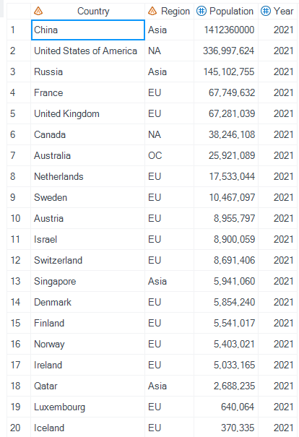
Nations sorted by population
China and the US have the highest population counts of all the countries we collected data for
These countries also had the highest government expenditure on education
Supports theory that nations with higher populations will naturally need to spend more to meet the educational needs of citizens
Luxembourg and Iceland have the lowest population counts
They also had the lowest educational spending
Less citizens = less money needed to satisfy educational needs of population
Luxembourg had the highest GDP/ per capita
Low population means wealth is inflated per capita

Slide 24
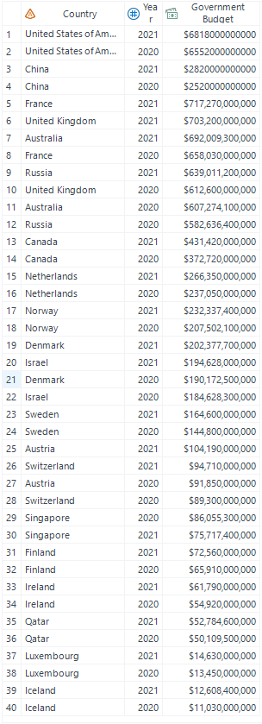
Government budgets between 2020 and 2021
United States and China have highest overall government budget
Consistently have highest education expenditure too
Iceland and Luxembourg have the lowest overall government budget
Also have lowest education expenditures
Luxembourg has highest GDP/ per capita
Wonder how their budget compares as a percentage of their GDP
Most nation’s budgets did not change drastically between 2020 and 2021
Larger countries tend to spend more overall
China, France, U.K., U.S, Canada
Countries with thorough social programs also ranked higher on overall government budget
Netherlands, Norway, Denmark

Slide 25
Summary/Conclusion

Slide 26
Summary
In this project, our goal was to formulate answers to the following two questions:
Is there a strong connection between nation well being and government support/expenditure on education?
Is there a correlation between income, education level, and fatalities from COVID-19 in the U.S?

Slide 27
Conclusions
Our hypotheses were as follows:
1. There is a positive correlation between government expenditure on education and nation wellbeing
2. There is no correlation between income and education levels on COVID-19 fatalities in the United States.
Both of these hypotheses were proven incorrect. There is a lack of a strong correlation between government expenditure on education and nation well-being. However, there is evidence to suggest that a correlation exists between age, education, and COVD-19 fatality rates in the United States. .

Slide 28
References
United Nations. (n.d.). Undata. United Nations. Retrieved April 13, 2023, from https://data.un.org/Default.aspx
Mueller, A. L., McNamara, M. S., & Sinclair, D. A. (2020). Why does COVID-19 disproportionately affect older people?. Aging, 12(10), 9959–9981. https://doi.org/10.18632/aging.103344
General government expenditure 2022. countryeconomy.com. (n.d.). Retrieved April 19, 2023, from https://countryeconomy.com/government/expenditure/
Government expenditure on education, total (% of government expenditure). World Bank Open Data. (n.d.). Retrieved April 19, 2023, from https://data.worldbank.org/indicator/SE.XPD.TOTL.GB.ZS
Frelle-Petersen, C., Hein, A., & Christianson, M. (n.d.). The Nordic Social Welfare Model. Retrieved April 20, 2023, from https://www2.deloitte.com/content/dam/insights/us/articles/43149-the-nordic-social-welfare-model/DI_The-Nordic-social-welfare-model.pdf
Brock, T. (Ed.). (2023, March 31). GDP per capita defined: Applications and highest per country. Investopedia. Retrieved April 19, 2023, from https://www.investopedia.com/terms/p/per-capita-gdp.asp

